Slide 1
Python in Data Science
Yaroslav Shtogun

Slide 2
Why Python in Data Science?
Easy to Learn (a short learning curve) and Similarity to other languages (C++, C#, Matlab,…)
Readable and Maintainable Code (emphasizes on code readability)
Multiple Programing Paradigms (functional and object-oriented programing )
Compatible with Major Platforms and Systems
Robust Data Science Library (many libraries to help with programming) and support from python community
Many Open Source Framework and Tools (web application development - Django, Flask, Pyramid; ML/AI – Pytorch, TensorFlow, Keras)
Simplify Complex Software Development (ML and AI development)
Adopt Test Driven Development (easy way to create prototypes)

Slide 3
Data Science Resources
Kaggle (https://www.kaggle.com/)
Youtube (many Python Data Science tutorials)
Krish Naik: https://www.youtube.com/channel/UCNU_lfiiWBdtULKOw6X0Dig
Data Science Coerces/Bootcamp (Data Science Dojo)
Coursera, Udamy, edX, Udacity, DataCamp
FastAI: Practical Deep Learning for Coders (https://course.fast.ai/) by Sylvain Gugger and Jeremy Howard
Data Science Podcast
Data Skeptic, Linear Digression, Data Frame (DataCamp), Data Stories, Machine Learning (Sandford)
Lex Fridman, TWIML, DataBook, Analytics on Fire, DataHack Radio, Analytics Vidhya
Medium: Towards Data Science; Artificial Intelligence
Books: Python for Data Analysis; Hands-on Machine Learning with Scikit-Learn, Keras & TensorFlow; Deep Learning for Coders with Fastai and PyTorch; The Hundred-Page Machine Learning Book

Slide 4
How is Python Used for Data Science?
Programming languages like Python are used at every step in the data science process. For example, a data science project workflow might look something like this:
1. Using Python and SQL, you write a query to pull the data you need from your company database.
2. Using Python and the pandas library, you clean and sort the data into a dataframe (table) that's ready for analysis.
3. Using Python and the pandas and matplotlib libraries, you begin analyzing, exploring, and visualizing the data.
4. After learning more about the data through your exploration, you use Python and the scikit-learn library to build a predictive model that forecasts future outcomes for your company based on the data you pulled.
5. You arrange your final analysis and your model results into an appropriate format for communicating with your coworkers.

Slide 5
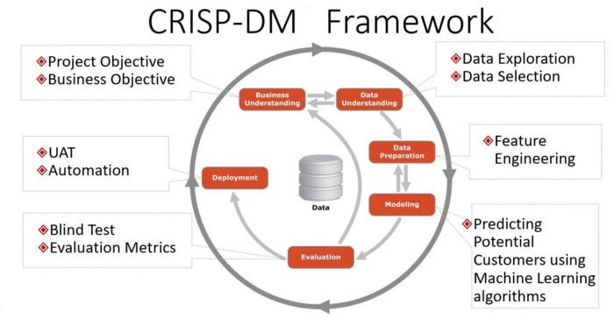
CRISP-DM: Cross-Industry Process for Data Mining
https://medium.com/@sumit.yg/analyzing-seattle-s-airbnb-listings-data-49abdc0977c8

Slide 6
https://scikit-learn.org/stable/user_guide.html

Slide 7
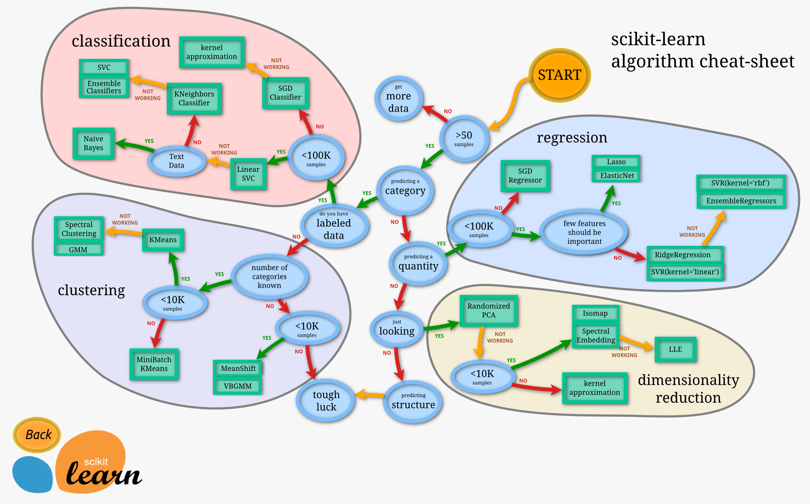
Next Step
https://scikit-learn.org/stable/tutorial/machine_learning_map/index.html

Slide 8
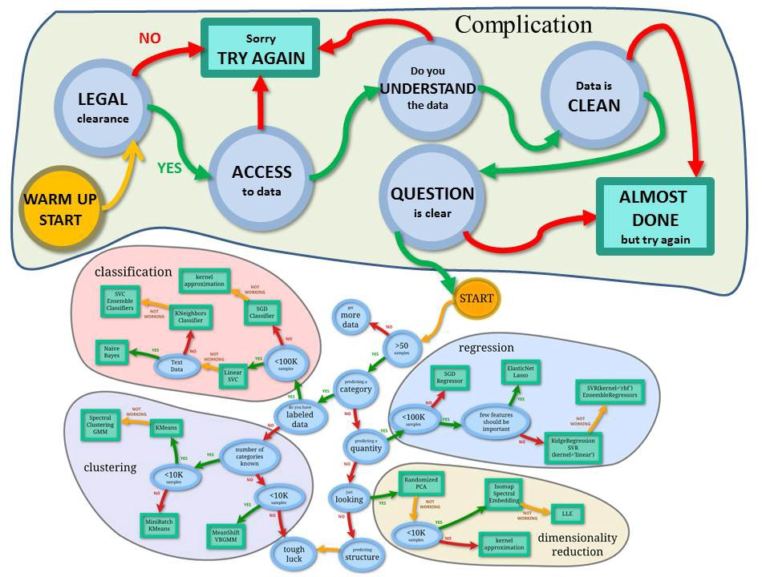
Next Step
https://medium.com/@chris_bour/an-extended-version-of-the-scikit-learn-cheat-sheet-5f46efc6cbb

Slide 9
Next Step
Dealing with missing data
Handling categorical data
Clustering Modeling
Classification Modeling
Regression Modeling
Dimensionality Reduction

